Slide 1
False Discovery Rate – An Example

Slide 2
False Discovery Rate – Another Example

Slide 3
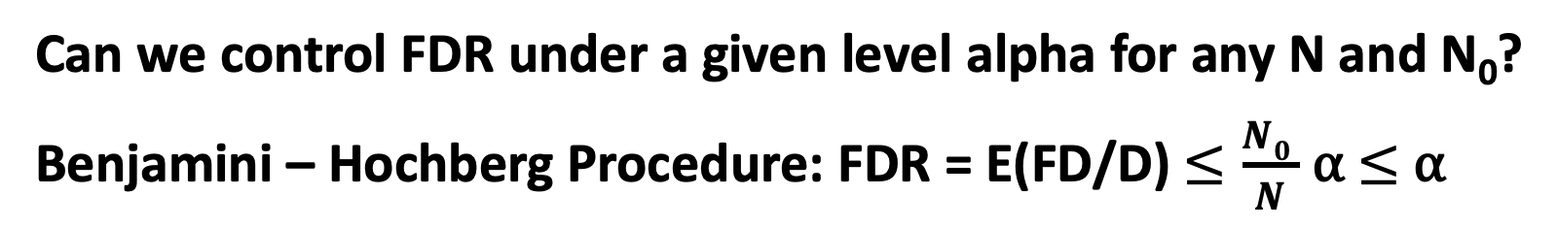
False Discovery Rate
Can we control FDR under a given level alpha for any N and N₀?
Benjamini – Hochberg Procedure: FDR = E(FD/D) $≤\frac{N0 }{N}$ ⍺ $≤$ ⍺

Slide 4
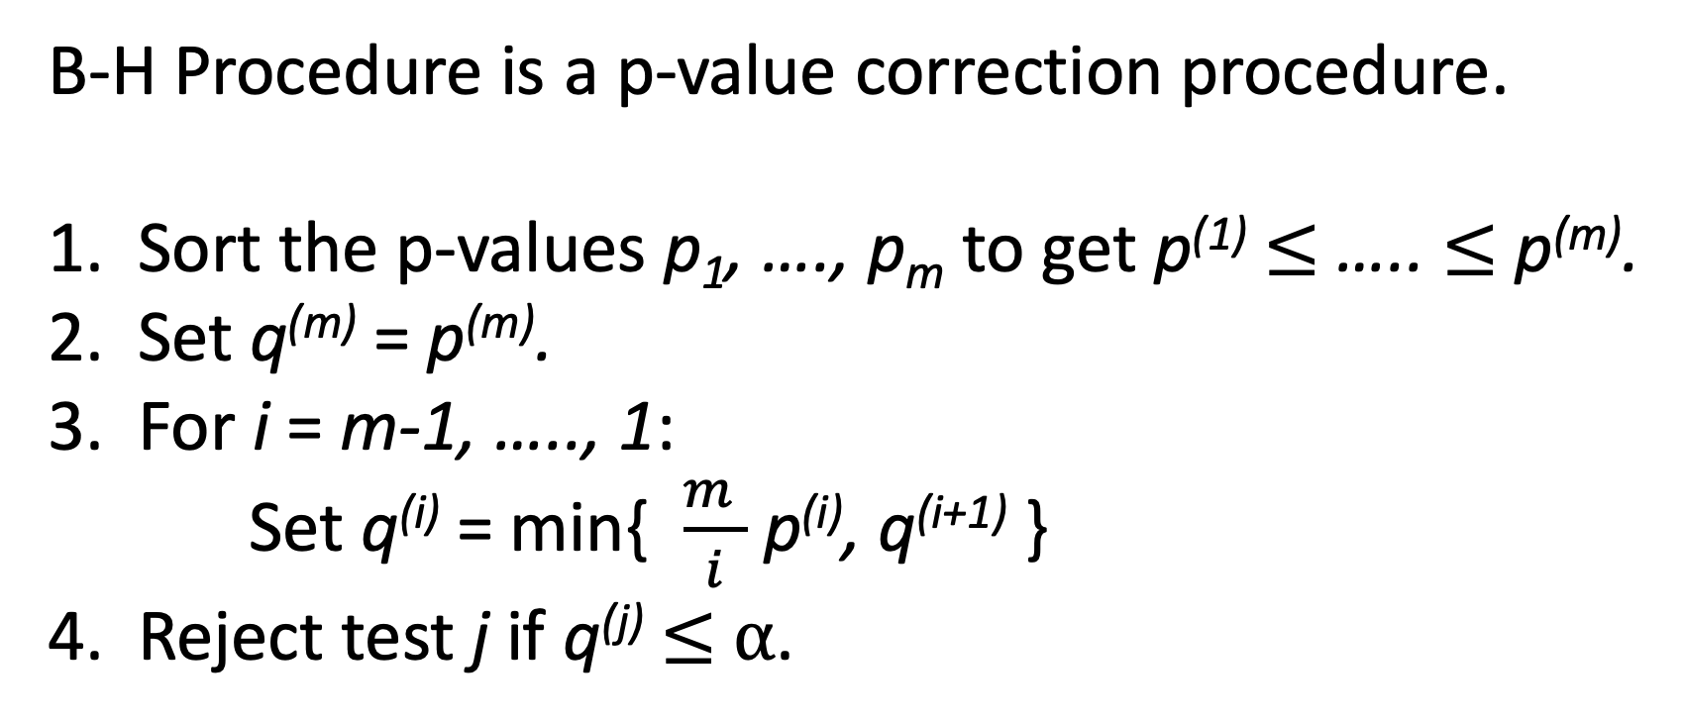
Benjamini–Hochberg Procedure - Algorithm
B-H Procedure is a p-value correction procedure.
Sort the p-values p₁, …., p_{m} to get p⁽¹⁾ $≤$ ….. $≤$ p^{(m)}.
Set q^{(m)} = p^{(m)}.
For i = m-1, ….., 1:
Set q^{(i)} = min{ $\frac{m }{i}$ p^{(i)}, q^{(i+1)} }
4. Reject test j if q^{(j)} $≤$ ⍺.

Slide 5
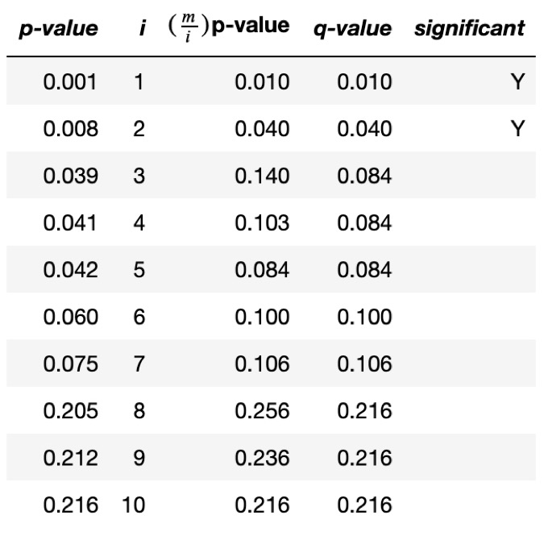
Benjamini–Hochberg Procedure – An Example

Slide 6
Benjamini–Hochberg Procedure – Performance
N: 4, 8, 16, 32, 64
N₀: 0%, 25%, 50%, 75% of N
Null True: N₀ samples from N(0, 1)
Alternative True:
(N-N₀) / 4 samples from N(1.25, 1)
(N-N₀) / 4 samples from N(2.50, 1)
(N-N₀) / 4 samples from N(3.75, 1)
(N-N₀) / 4 samples from N(5.00, 1)
⍺ = 0.05
10,000 simulation runs for each experiment setup.

Slide 7
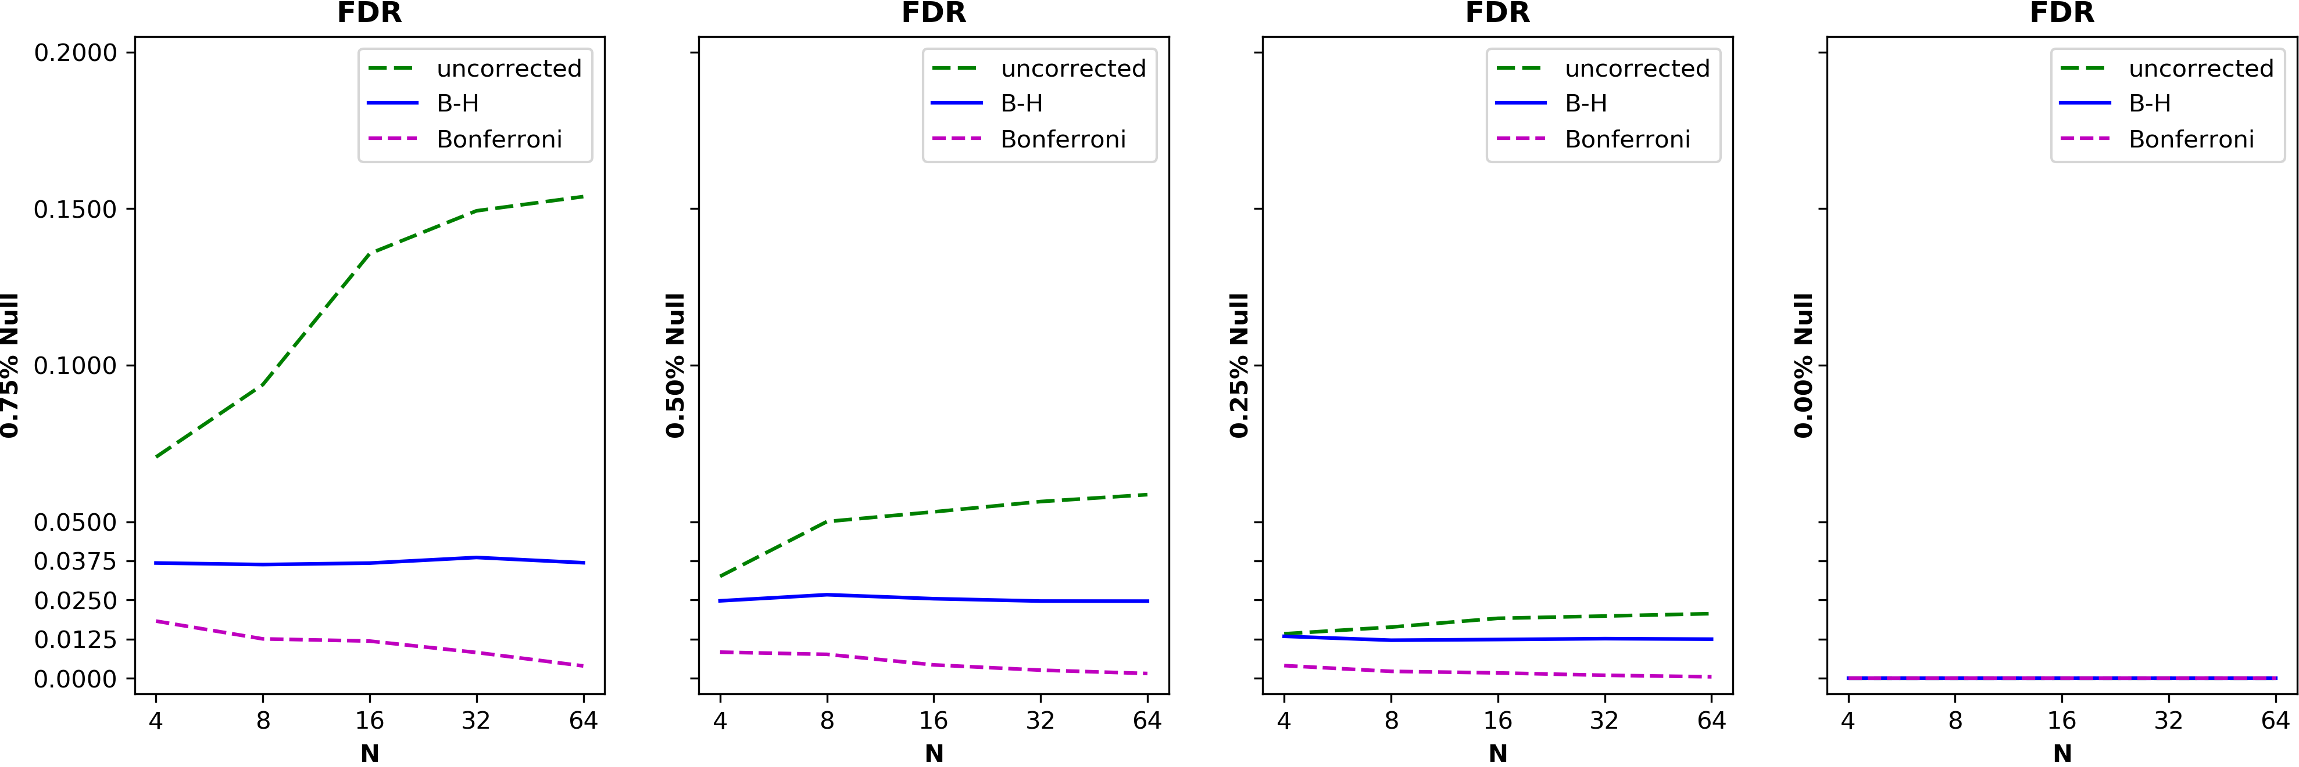
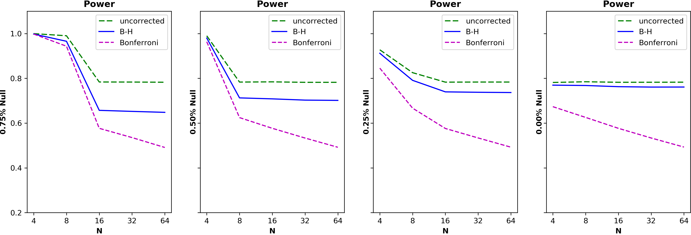
Benjamini–Hochberg Procedure – Performance

